Slide 1
Basics to Earth Engine and GitHub

Slide 2
Introduction to JavaScript
This introduction covers getting started with JavaScript
GEE is built on JavaScript API and Python API
The code editor is the interface to interact with the JavaScript api

Slide 3
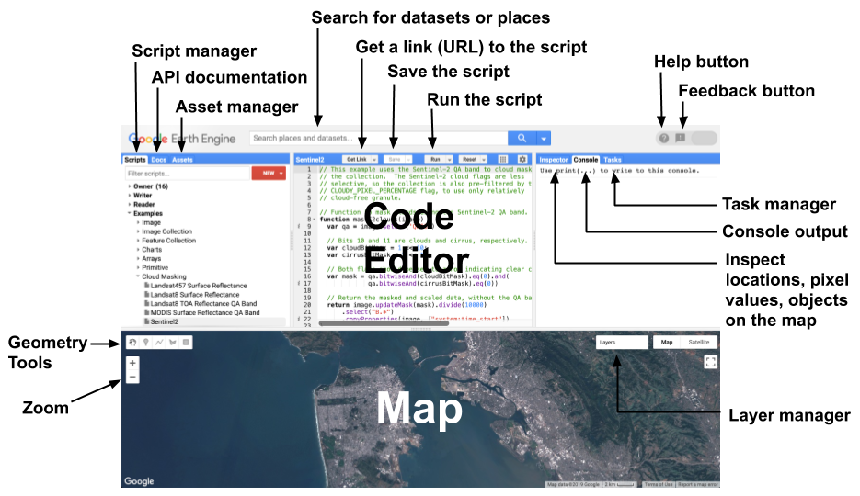
Introduction to GEE Code Editor
https://code.earthengine.google.com/

Slide 4
Introduction to JavaScript
Go to code.earthengine.google.com and copy the following into the Code Editor and click on run
Learning by doing
print('Hello World!’);
// print('Hello World!’);
print (’This is my first JavaScript code’)
Run in Code Editor

Slide 5
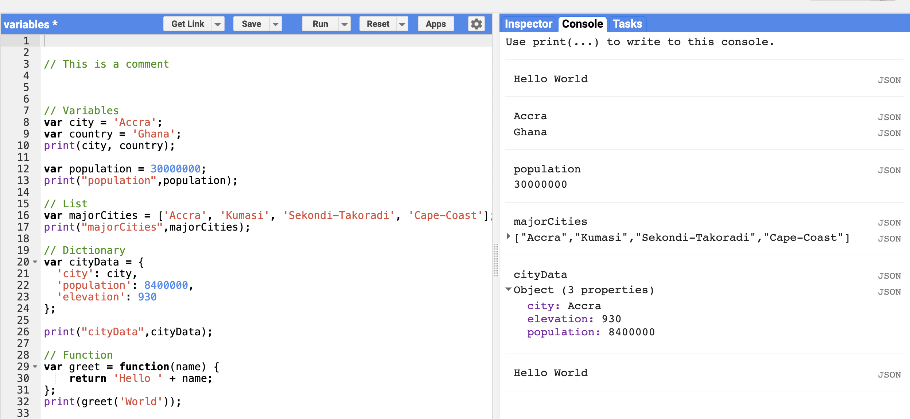
Variables
Variables are containers for storing elements.
// In Javascrript a variable is declared using var.
Varibles can store strings, numbers,list,tuples ,etc.
Example
var school = “University of Ghana“
var year = [2015,2016,2017,2018]
var a = 23
var b = 11
var c = a + b
print ( c )
print(school)
Run in Code Editor

Slide 6
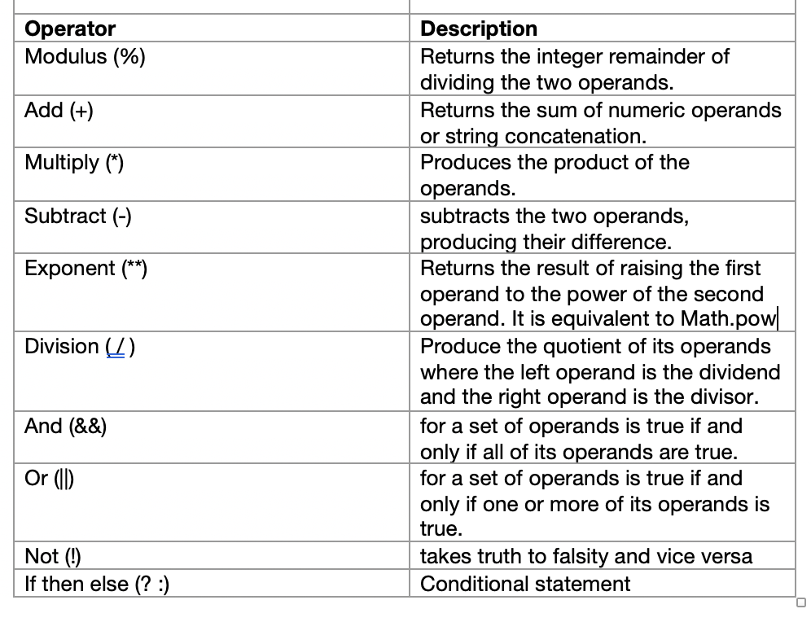
OPERATIONAL SYMBOLS IN JAVASCRIPT

Slide 7
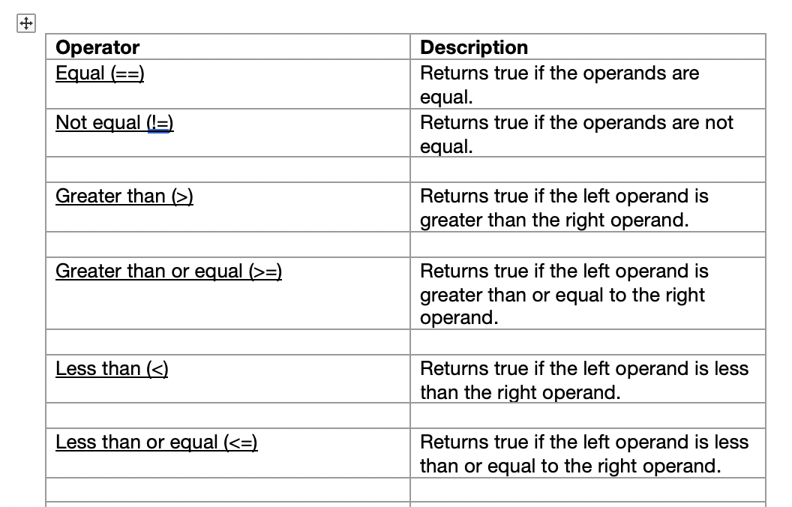
OPERATIONAL SYMBOLS IN JAVASCRIPT

Slide 8
Some GEE Operators
// Load a Landsat 8 image. var image = ee.Image('LANDSAT/LC08/C01/T1_TOA/LC08_044034_20140318'); // Create NDVI and NDWI spectral indices. var ndvi = image.normalizedDifference(['B5', 'B4']); var ndwi = image.normalizedDifference(['B3', 'B5']); // Create a binary layer using logical operations. var bare = ndvi.lt(0.2).and(ndwi.lt(0)); // Mask and display the binary layer. Map.setCenter(-122.3578, 37.7726, 12); Map.setOptions('satellite'); Map.addLayer(bare.selfMask(), {}, 'bare');
Operator | Description
eq() | Equal
gt() | Greater than
gte() | Greater than or equal
lt() | Less than
lte() | Less than or equal

Slide 9
Math object
Math.random(); // returns a random number
Math.min(0, 150, 30, 20, -8); // returns -8 Math.round(4.7); // returns 5
Math.round(4.4); // returns 4
Math.ceil(4.4); // returns 5
Math.floor(4.4); // returns 4
Math.E; // returns Euler's number
Math.PI // returns PI
Math.SQRT2 // returns the square root of 2 Math.SQRT1_2 // returns the square root of 1/2
Math.LN2 // returns the natural logarithm of 2
Math.LN10 // returns the natural logarithm of 10 Math.LOG2E // returns base 2 logarithm of E Math.LOG10E // returns base 10 logarithm of E

Slide 10
Basic JavaScript data types
For the purpose of this training we will be looking at the below data types ;
Strings
Numbers
Lists
Dictionary
Objects
Functions

Slide 11
JavaScript / GEE data types
Strings
Using variables to store objects and primitives helps code readability. For example, a variable that stores a string object is defined by single ' or double " quotes (but don't mix them), with single quotes preferred. Make a new string and store it in a variable called greetString:
// Use single (or double) quotes to make a string. var greetString = 'Ahoy there!’;
var greetString2 = "Ahoy there!";
// Use parentheses to pass arguments to functions. print(greetString);
print(greetString2);

Slide 12
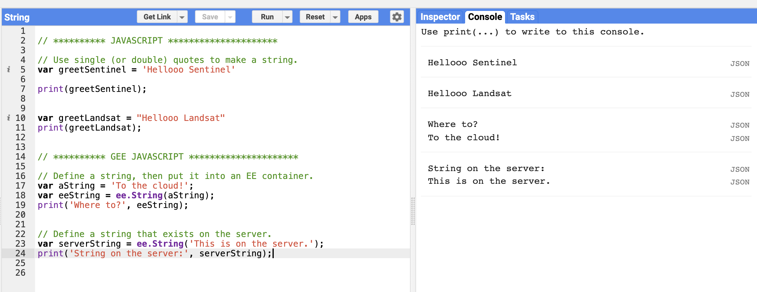
JavaScript / GEE data types
String(GEE)
// Define a string, then put it into an EE container. var aString = 'To the cloud!'; var eeString = ee.String(aString); print('Where to?', eeString);
Think of ee.Thing as a container for a thing that exists on the server. In this example, the string is defined first, then put into the container. You can also define the container and its contents all at once. For example:
// Define a string that exists on the server. var serverString = ee.String('This is on the server.'); print('String on the server:', serverString);
Run in Code Editor

Slide 13
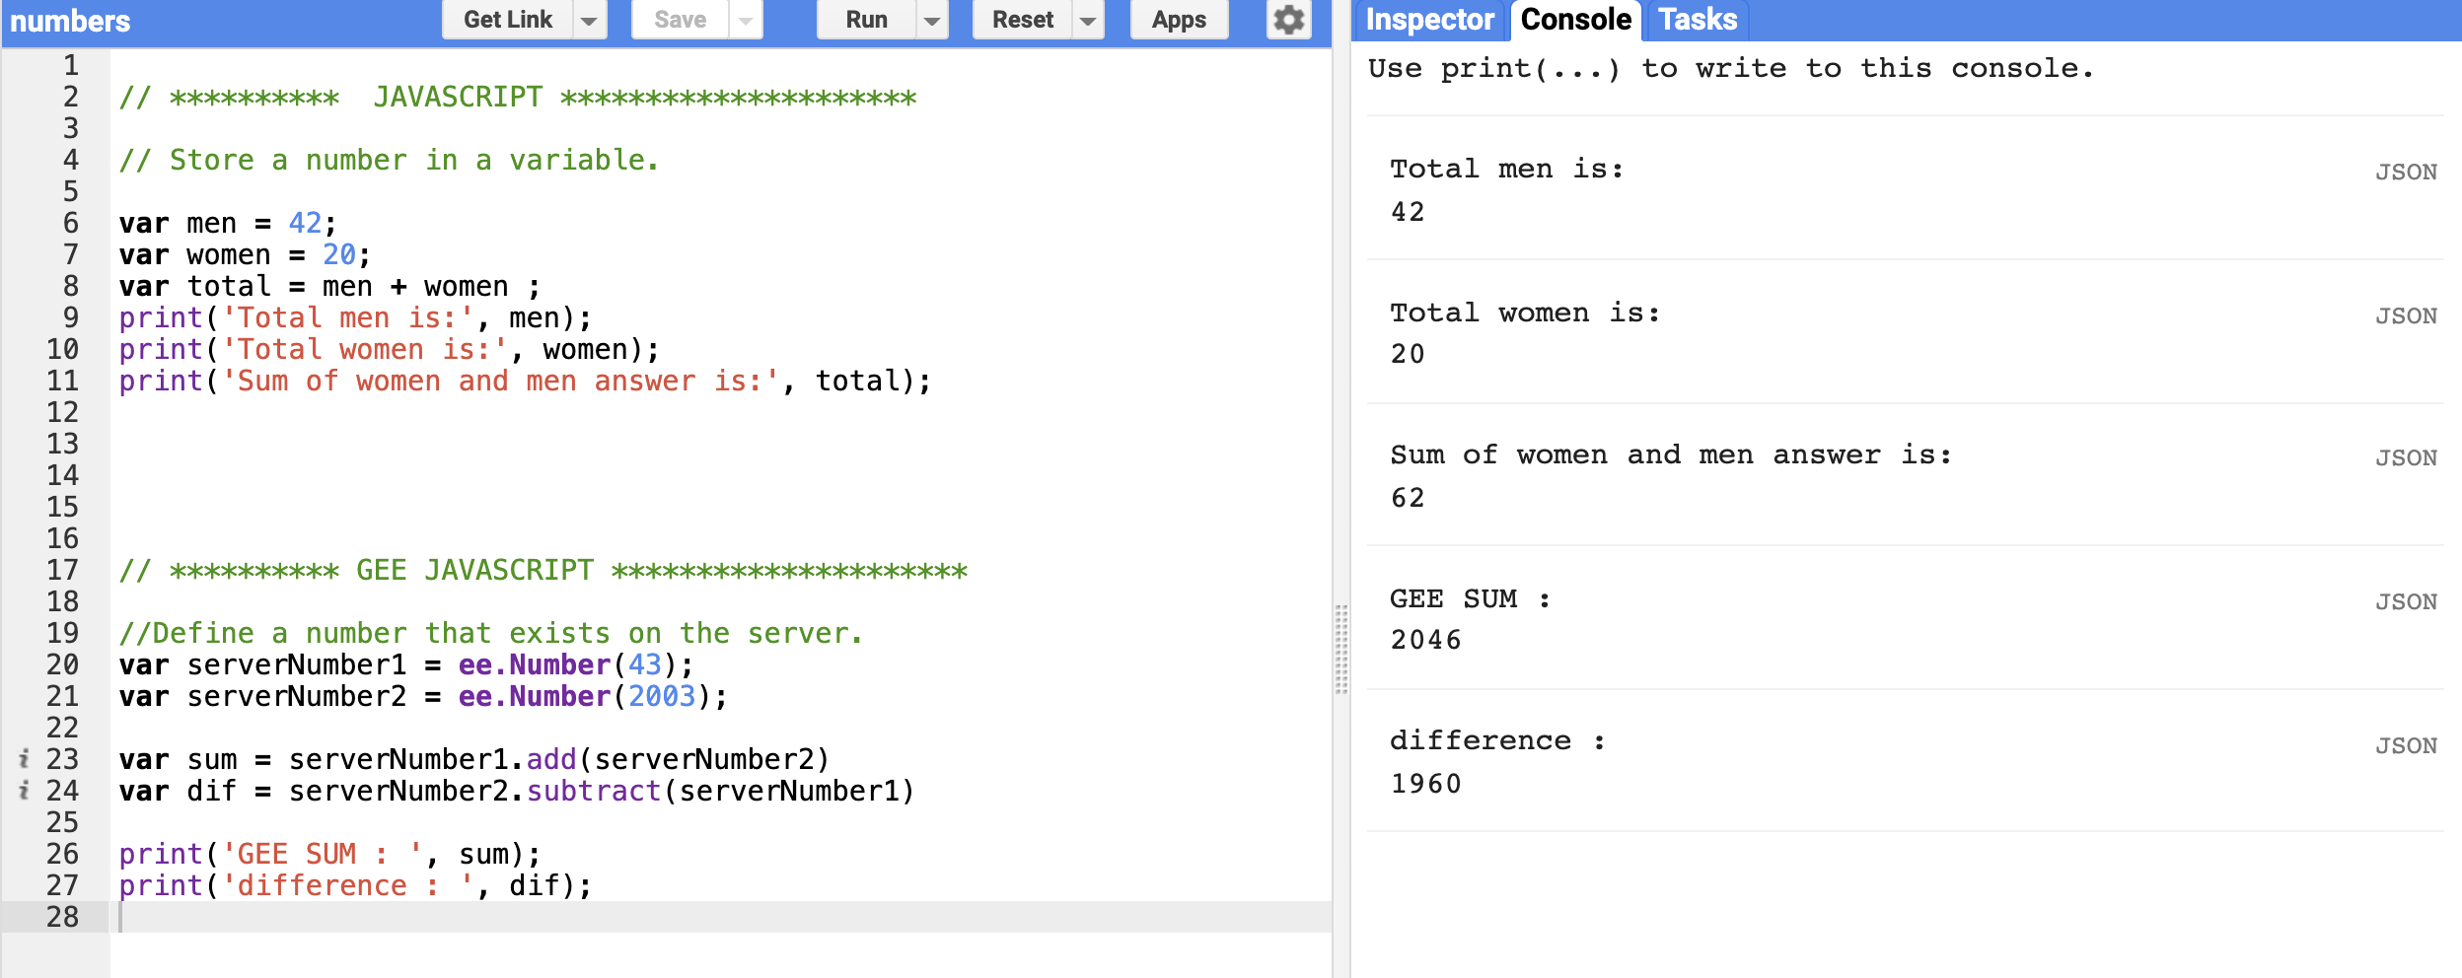
JavaScript / GEE data types
Numbers
Note that variables are defined with the keyword var. Variables can also store numbers: // Store a number in a variable. var men = 42;
var women = 20;
var total = men + women ;
print(‘Total men is:', men);
print(‘Total women is:', women);
print(‘Sum of women and men answer is:', total);

Slide 14
JavaScript / GEE data types
Numbers (GEE)
Use ee.Number() to create number objects on the server. For example, use the Math.E JavaScript method to create a constant value on the server:
// Define a number that exists on the server. var serverNumber = ee.Number(Math.E); print('e=', serverNumber);
The ee.String() and ee.Number() methods are constructors. A constructor takes its argument (and possibly other parameters), puts it in a container, and returns the container and its contents as an Earth Engine object that you can manipulate in your code. Any constructor starting with ee returns an Earth Engine object.
Run in Code Editor

Slide 15
JavaScript / GEE data types
Lists
Define lists with square brackets []. A list of numbers, for example:
// Use square brackets [] to make a list. var listOfNumbers = [0, 1, 1, 2, 3, 5]; print('List of numbers:', listOfNumbers);
Lists can also store strings or other objects. For example:
// Make a list of strings. var listOfStrings = ['a', 'b', 'c', 'd']; print('List of strings:', listOfStrings);

Slide 16
JavaScript / GEE data types
Lists (GEE)
To make a JavaScript list into an ee.List object on the server, you can put a JavaScript literal into a container as with numbers and strings. Earth Engine also provides server-side convenience methods for making sequences of numbers. For example:
// Make a sequence the hard way. var eeList = ee.List([1, 2, 3, 4, 5]); // Make a sequence the easy way! var sequence = ee.List.sequence(1, 5); print('Sequence:', sequence);
Since the ee.List objects only exist on the server, use Earth Engine provided functions to interact with them. For example, to get something out of the list, use the get() method of the ee.List object:
// Use a method on an ee.List to extract a value. var value = sequence.get(2); print('Value at index 2:', value);
Run in Code Editor

Slide 17
JavaScript / GEE data types
Objects(Dictionary)
Objects in JavaScript are dictionaries of key: value pairs. Make an object (or dictionary) using curly brackets {}, for example:
// Use curly brackets {} to make a dictionary of key:value pairs.
var object = {
foo: 'bar',
baz: 13,
stuff: ['this', 'that', 'the other thing']
};
print('Dictionary:', object);
// Access dictionary items using square brackets.
print('Print foo:', object['foo']);
// Access dictionary items using dot notation.
print('Print stuff:', object.stuff);

Slide 18
JavaScript / GEE data types
Dictionaries (GEE)
You can construct an Earth Engine Dictionary from a JavaScript object, as with strings, numbers and lists. At construction time, you can use JavaScript functionality to initialize the Earth Engine object. In this case an ee.Dictionary is constructed directly from a JavaScript literal object:
// Make a Dictionary on the server. var dictionary = ee.Dictionary({ e: Math.E, pi: Math.PI, phi: (1 + Math.sqrt(5)) / 2 }); // Get some values from the dictionary. print('Euler:', dictionary.get('e')); print('Pi:', dictionary.get('pi')); print('Golden ratio:', dictionary.get('phi')); // Get all the keys: print('Keys: ', dictionary.keys());
Run in Code Editor

Slide 19
JavaScript / GEE data types
Dates
Date objects are the way Earth Engine represents time. As in the previous examples, it is important to distinguish between a JavaScript Date object and an Earth Engine ee.Dateobject. Construct an ee.Date from a string, from a JavaScript Date, or using static methods provided by the ee.Date class. (See the Date section in the Docs tab for details).
// Define a date in Earth Engine. var date = ee.Date('2015-12-31'); print('Date:', date); // Get the current time using the JavaScript Date.now() method. var now = Date.now(); print('Milliseconds since January 1, 1970', now); // Initialize an ee.Date object. var eeNow = ee.Date(now); print('Now:', eeNow);
Run in Code Editor

Slide 20
JavaScript / GEE data types
Arrays and Array Images
Arrays in Earth Engine are constructed from lists of numbers and lists of lists. The degree of nesting determines the number of dimensions.
var coefficients = ee.Array([
[0.3037, 0.2793, 0.4743, 0.5585, 0.5082, 0.1863],
[-0.2848, -0.2435, -0.5436, 0.7243, 0.0840, -0.1800],
[0.1509, 0.1973, 0.3279, 0.3406, -0.7112, -0.4572],
[-0.8242, 0.0849, 0.4392, -0.0580, 0.2012, -0.2768],
[-0.3280, 0.0549, 0.1075, 0.1855, -0.4357, 0.8085],
[0.1084, -0.9022, 0.4120, 0.0573, -0.0251, 0.0238]
]);
print(“coefficients” , coefficients)
Run in Code Editor

Slide 21
JavaScript / GEE data types
Functions
Functions are another way to improve code readability and reusability by grouping sets of operations. Define a function with the function keyword. Function names start with a letter and have a pair of parentheses at the end. Functions often take parameters which tell the function what to do. These parameters go inside the parentheses (). The set of statements making up the function go inside curly brackets. The return keyword indicates what the function output is. There are several ways to declare a function, but here we'll use something like this:
var myFunction = function(parameter1, parameter2, parameter3) { statement; statement; statement; return statement; };

Slide 22
JavaScript / GEE data types
Functions
// The reflect function takes a single parameter: element. var checklength = function(list) {
var results
if (list.length > 3){
results = "the list has more than 4 elements"
}else{
results = "the list has less than 4 elements"
}
return results;
};
var image = ["Modis", "Landsat7", "Sentinel", "Sentinel2"];
print(checklength(image))
GEE Sample
var myList = ee.List.sequence(1, 10);
// The reflect function takes a single parameter: element. var computeSquares = function(number) {
// We define the operation using the EE API.
return ee.Number(number).pow(2);
};
var squares = myList.map(computeSquares);
print(squares);

Slide 23
Functional Programming Concepts
Earth Engine uses a parallel processing system to carry out computation across a large number of machines.
For Loops
The use of for-loops is discouraged in Earth Engine. The same results can be achieved using a map() operation where you specify a function that can be independently applied to each element. This allows the system to distribute the processing to different machines.
If/Else Conditions
if/else conditional operators in Earth Engine is strongly discouraged . map() and filters are more functional approach .
Run in Code Editor

Slide 24
Resource Materials
the Code Editor guide to get familiar with the Code Editor environment.
For more thorough JavaScript tutorials, see these Mozilla developer resources.
For an introduction to programming, with examples in JavaScript, see Eloquent JavaScript.
For suggestions on JavaScript coding style, see the Google JavaScript Style Guide.

Slide 25

GITHUB USER INTERFACE
https://github.com/

Slide 26
GITHUB USER INTERFACE

